Slide 1
Boot Camp Triple Play: 3 Steps to Maximize Your Social Media ROI
May 21, 2015
Felicia Williamson, MLIS, CA
James Williamson, MLIS, CA, DAS
#SSA2015 #SSAtripleplay

Slide 2
What to expect
Section 1: Marketing Finding Aids on Social Media
Section 2: Book GIFs
Section 3: Video GIFs
Section 4: Animated GIFs

Slide 3
A doable solution: Marketing Finding Aids on Social Media Felicia J. Williamson, MLIS, CA

Slide 4
A Challenge
Started position at SHSU in 2011.
No online presence
No finding aids or processed collections
Implemented Archon in 2012.
20 finding aids the first year
Up to 75 finding aids by Spring 2015
Devised research project in 2012 to launch 10 social media sites and market finding aids on each to determine which site brought the highest ROI.

Slide 5
We got results!
WordPress, Tumblr, Facebook, Twitter and Google+ stood apart from the rest.
Doubled traffic to finding aids and increased rankings in Google.
We were psyched!
Party Gif. http://giphy.com/gifs/vintage-party-champagne-BJH2ALum77Vni Accessed 5/13/2015.

Slide 6
Our message – this is doable.
Create post on a blog using collection’s biographical/ note and scope and contents note and some scanned images of collection highlights.
Repost blog entry on other top social media sites.

Slide 7
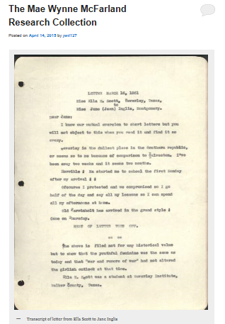
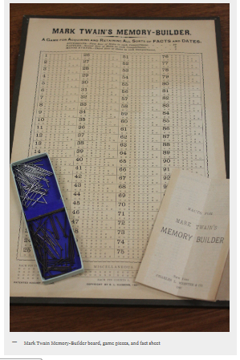
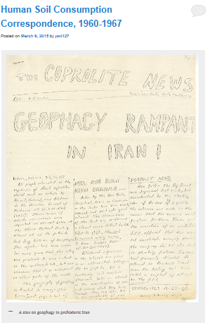
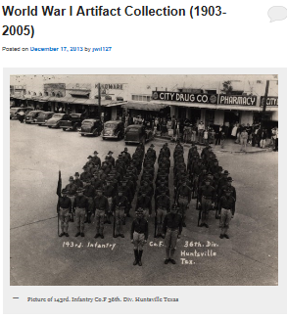
Doable Step I: Images
First step: populate the blog with a image or two from the collection
Choose high-impact, colorful images.
Make image selection and scanning part of your processor’s workflow.

Slide 8
Doable Step II: Finding aid to post (Presto Change-o)
Second step: use the biographical/ historical note and scope and contents notes as the backbone of the initial post to the blog.
How doable is it? We literally cut and paste this content from our Finding Aids Online (Archon) interface into WordPress.
Finding Aids Online (Archon)
Post on WordPress

Slide 9
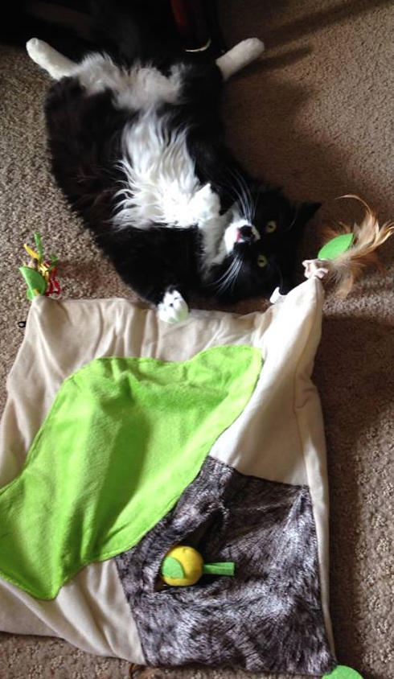
Doable Step III: Add a link
Final Step: Close out your post with a link to the finding aid.
Sit back, relax, and wait for those reference requests!
Cordelia Everton Smythe. Extremely relaxed kitty, unless there is a food shortage. Photo by Felicia Williamson.

Slide 10
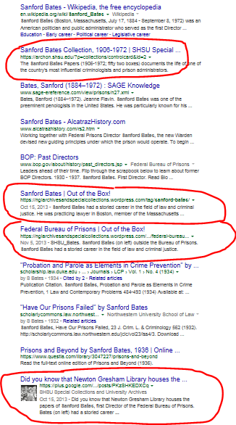
Expand your reach!
It’s easy to do a little cross-promotion.
Take it further and repost to Facebook, Tumblr, Google + and Twitter (with slight modifications.)
Then you can look forward to Google search results like →
One link to Finding Aids Online (Archon)
Two blog posts
And Google +!

Slide 11
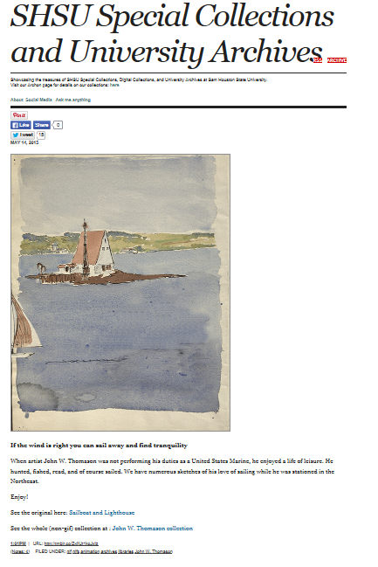
Blog to Tumblr
Copy and paste your blog entry to Tumblr
You can automatically re-blog your post from WordPress to Tumblr. We recommend you copy and paste since a re-blog to Tumblr cuts the post off and patrons will have to click to “see more” and just be re-routed to WordPress.
Tumblr is great for audience participation.

Slide 12
Then- Facebook and Google+
Shorten your post (2 VIP sentences from Biog/Hist and 2 VIP sentences from Scope/ Contents) and post this shortened version (with image and link) to Facebook and Google+
It is ok to use the full version, but a good part of your post and most importantly, the link, will just get cut off and appear “below the fold” …
Google + keeps your finding aid post high in Google search results (caveat: we aren’t sure how this works…next research project!)
Kent District Library Blog
http://blog.kdl.org/?p=3307 Accessed 5/14/15.

Slide 13
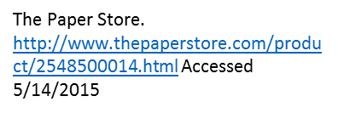
Twitter-time
Write a 140 word version of your post. Tweet it with tags.
Tag related organizations (alumni, University tags, student group tags, historical society tags, etc.) are a great way to expand your reach (and build relationships. Tag it up, especially on Twitter, Facebook and Tumblr.

Slide 14
Check it out!
The blog: https://nglarchivesandspecialcollections.wordpress.com/
Tumblr: http://nglspecialcollectionsandarchives.tumblr.com/
Facebook: https://www.facebook.com/shsulibrary?sk=wall
Twitter: https://twitter.com/SHSUArchives
Google+: https://plus.google.com/108066714015732776161/posts

Slide 15
Questions?

Slide 16
How to Make GIFs from your Collections
James Williamson, MLIS, CA, DAS

Slide 17
What is a GIF?
Stands for graphics interchange format
Basically an animated format for the web that can be created from images, illustrations, and videos.
Laker Bros http://deadspin.com/5961953/i-cant-stop-looking-at-this-gif-of-these-two-lakers-bros Accessed 5/12/2015

Slide 18
Why should I use them?
Language of the internet
-especially on youth driven sites like Tumblr
A number of institutions have found success using them
-SHSU GIFs have been featured multiple times on Tumblr Radar. Each appearance on the Radar resulted in a substantial bump in followers.
Swing And a Miss http://nglspecialcollectionsandarchives.tumblr.com/post/79459655927/swing-and-a-miss-this-polo-player-just-cannot Accessed 5/12/2015

Slide 19
Book GIFs
GIFs created from books in your collection
-miniature books, art books, rare books, weird books, etc.
Popular on the web and simple to put together
Painted Fans of Japan http://nglspecialcollectionsandarchives.tumblr.com/post/60773527021/painted-fans-of-japan-check-out-this-miniature Accessed 5/12/2015

Slide 20
You can use any type of book
Yellowstone Spring @SHSU http://nglspecialcollectionsandarchives.tumblr.com/post/78443128652/yellowstonespringatshsu Accessed 5/12/2015
John W. Thomason Sketchbook 34 http://nglspecialcollectionsandarchives.tumblr.com/post/80275800886/john-w-thomason-sketchbook-34-we-have-thousands Accessed 5/14/2015

Slide 21
Technical requirements for Book GIFs
Low resolution
-72 Pixels/Inch
Maximum width
-500 pixels
Recommend 10 frames or less

Slide 22
How to create Book GIFs
Step one
-Take a series of photos of a book from your collection
-Highlight cover and inside contents
-If it has a unique feature, highlight it
Step two
-Open each image into Photoshop
Step three
-On each image, right click the background layer and select “duplicate layer”
-Select the first image as the destination for the duplicated layer
Step four
-Select Windows and click the Timeline feature
-Select Create Frame Animation
Step Five
-Using the eyes found next to each layer, select the layer that needs to appear in each frame (uncheck all other layers)
Step Six
-Use the delay feature to set speed between frames
Step Seven
-Adjust the width to 500 pixels and 72 pixels/inch
Step Eight
-Use save for web to save in the GIF format

Slide 23
Questions?

Slide 24
Video GIFs
Step up from book gifs and a little harder to master
Clips contain a fun or interesting “hook”
You could create videos that work as a continuous loop
You could create a series of video GIFs that work as a set
VE Day: May 8, 1945 - The War Ends In Europe http://todaysdocument.tumblr.com/post/118440544677/ve-day-may-8-1945-the-war-ends-in-europe Accessed May 14/2015

Slide 25
Check out these examples!
Dr. Tetsuya Theodore Fujita Papers http://southwestcollectionarchives.tumblr.com/post/116409507278/severe-weather-season-is-upon-us-and-yet-without Accessed 5/15/2015
Criminal Justice Center Promotional video
Department of Criminal Justice Collection Accessed May 18, 2015

Slide 26
Technical requirements for Video GIFs
Maximum width
-500 pixel
Recommended 20-30 frames
File size needs to be around 1 MB
- Tumblr does allow up to 1.75MB but the smaller the better

Slide 27
Well that’s not very specific!
Multiple factors effect video gifs
-What is the quality of the video?
-It is black and white or color?
-What is the length of the clip that you want to use?
This means playing with features to get close to the 1 MB

Slide 28
Things you can do to affect the file size
Change resolution
-lowering to a point where it does not impact the quality of the video
Lossy Compression
-Using between 1 to 25 does not have too much of an effect
Limit color palate
-Lower the colors from 256 to either 128 or 64 may make a size difference without effecting the quality

Slide 29
How to create Video GIFs
Step one
-shorten video files in program like Premiere or Movie Maker from Windows (You do have this ability in Photoshop but it lacks precision)
Step two
-Import into Photoshop
-Convert Video frames to Layers
Step three
-Select file
-Option menu appears, select Limit to Every _ Frames
-Select between 4-6 frames
Step four
-Whittle down frames and adjust delays
Step five
-Select “save for web” to save in the GIF format
-Limit color quality or lossy compression

Slide 30
Questions?

Slide 31
Animation GIFs
Basically adding or manipulating elements in a work of art, photograph, or video still
Takes more time and effort but the potential payoffs can be enormous
-appearances on Tumblr Radar three times in two months bumped followers on Tumblr from 200-8,000
Row, Row, Row Your Boat http://nglspecialcollectionsandarchives.tumblr.com/post/78009734990/row-row-row-your-boat-watch-as-this-guy-rows Accessed 5/13/2015

Slide 32
Bring out your inner Monty Python!
Briggs, G.M. Matthew Roberts in His Army Uniform, Photograph, n.d.; (http://texashistory.unt.edu/ark:/67531/metapth20654/ : accessed May 19, 2015), University of North Texas Libraries, The Portal to Texas History, http://texashistory.unt.edu; crediting Tarrant County College NE, Heritage Room, Fort Worth, Texas.
Happy Holidays
http://nglspecialcollectionsandarchives.tumblr.com/post/105019157353/happy-holidays-from-sam-houston-state-university Accessed 5/19/2015

Slide 33
Creative but not time consuming
Focus on adding elements or manipulating a single item within the image
Simple and unexpected plays well and saves on time
Radioactivity is in the air for you and me http://nglspecialcollectionsandarchives.tumblr.com/post/84932095944/radioactivity-is-in-the-air-for-you-and-me-this Accessed 05/14/2015

Slide 34
How to create Animation GIFs
Step one
-Open image in Photoshop
Step two
-Using either Quick Selection or Lasso tool, layer selection Layer via Cut
Step three
-Create Frame Animation
Step four
-Either duplicate the cut layer or move the layer using the move tool and move the layer for each frame
-If you do not want a layer to appear, remove the eye on the layer for that frame
Step five
-Adjust frame speed to preference
Step six
-Fill in blank areas using the Clone stamp or History Brush
Step Seven
-Adjust Image size to 500 pixel width and 72 pixels/inch
Step Eight
-Use save for web to save in the GIF format

Slide 35
Questions?

Slide 36
Putting it all together

Slide 37
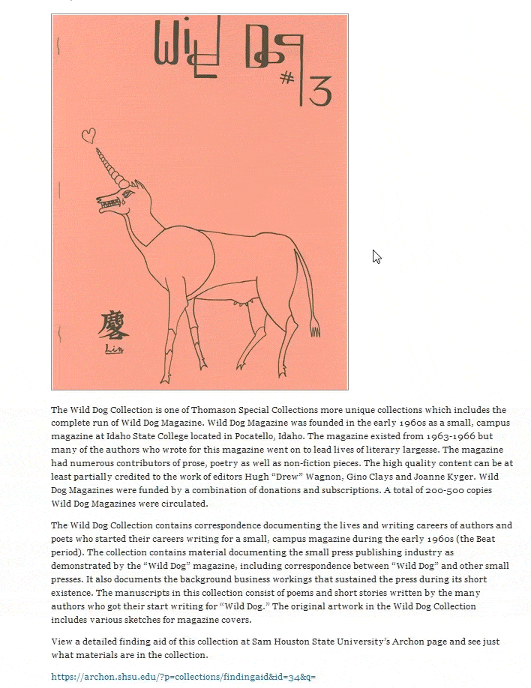

Slide 38
Resources
For Windows
For Mac
-GIF Brewery

Slide 39
Contact Information
James Williamson
Felicia Williamson
Email: jwilliamson@shsu.edu
Twitter: @metalarchivist
Tumblr: themetalarchivist
Email: fxt004@shsu.edu
Twitter:@effietothetrot

