Slide 1
SSA 2015 Boot Camp
Bit by bit: implementing a
Digital Preservation program
Woodson Research Center

Slide 2
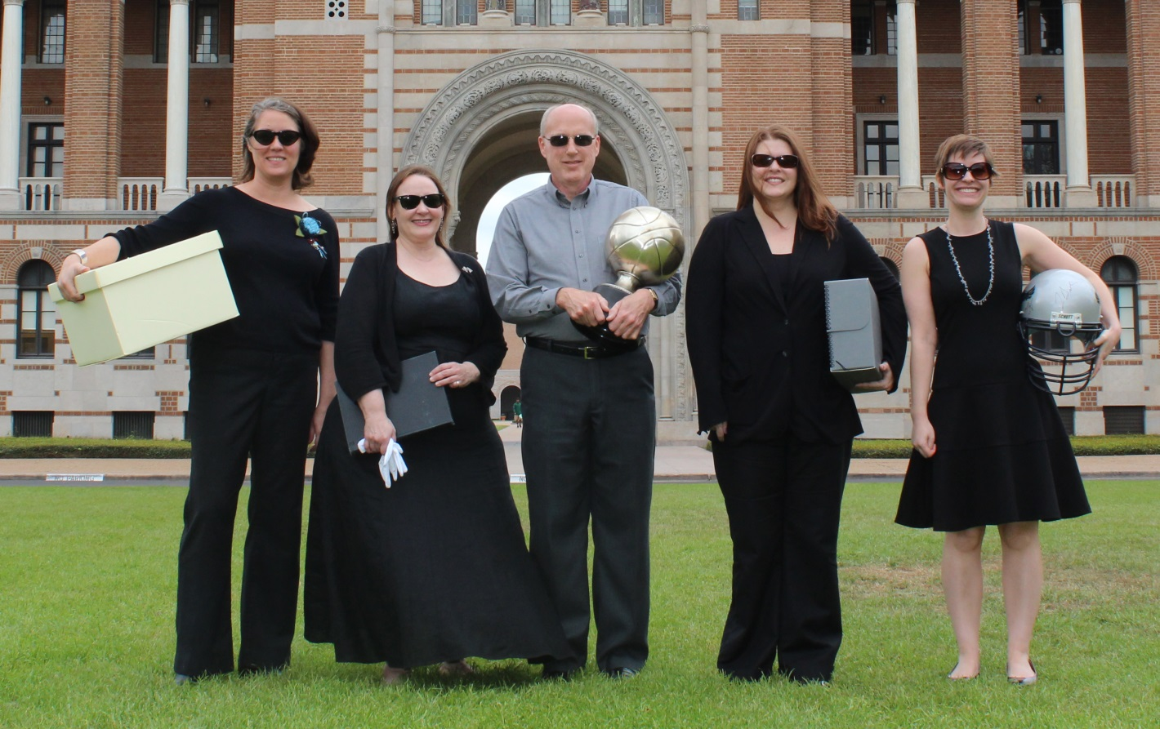
About Us
The team from Woodson Research Center, Fondren Library, Rice University
Amanda Focke, Dara Flinn, Lee Pecht, Rebecca Russell, Norie Guthrie

Slide 3
Boot Camp Structure
Share our institutional experience
Tasks to get you started

Slide 4
Learning Objectives
What we will cover:
Creating a policy
Surveying the collection
Applying the OAIS model to create information packages
What we won’t cover:
No in-depth discussion of digital forensics
No in-depth discussion of different tools
Preservation metadata
Storage options

Slide 5
Laying the Groundwork Our year of Digital Preservation begins…
Departmental goals for 2014 :
put in place the needed
institutional support
policies
workflows
software, hardware, and
staff skills
to have a true working digital preservation program.

Slide 6
Stakeholders
Vice Provost and University Librarian
Digital Scholarship Services
IT
Users
Donors
Us

Slide 7
Mission Statement
The mission of the Woodson Research Center, like that of its parent body, the Fondren Library of Rice University in Houston, Texas, is to support the institutional, research and public service programs of the University. The Center collects, organizes, preserves and describes official records of the University, special collections of rare books and manuscripts. It makes these materials available for Rice faculty, students and alumni, as well as local, national and international researchers via exhibitions, lectures, and other public events, and by publishing print and online materials highlighting the department's primary source collections. The Fondren Library is committed to providing the analog and digital preservation support which makes long-term access to its rare and unique materials possible.

Slide 8
Creation of a high-level digital preservation policy
The policy was based on the NEDCC template
https://www.nedcc.org/assets/media/documents/SoDAExerciseToolkit.pdf
Notes:
Founded in 1973, the Northeast Document Conservation Center is the first independent conservation laboratory in the nation to specialize exclusively in treating collections made of paper or parchment, such as works of art, photographs, books, maps, manuscripts, and more. Pass out the handout with the NEDCC Digital Preservation Policy Template

Slide 9
Items addressed in policy
Primary Policy Aims
Risk Assessment
Needs Statement
Project /Purpose Statement
Goals and Objectives
Projects to Undertake
Organizational Commitments
Developing a digital preservation policy…

Slide 10
Items addressed in policy, cont’d
Financial Commitments
Personnel
Preservation and Quality Control
Preservation Metadata
Roles and Responsibilities
Training and Education
Evaluating and Updating
Developing a digital preservation policy…

Slide 11
Overcoming Concerns
Archivists’ concerns
So much change at once
Time/training
IT concerns
Storage
Hardware/Software support
Developing a digital preservation policy…

Slide 12
Reading and Training
SAA Classes:
Arrangement and Description of Electronic Records
Digital Forensics
Achieving Email Account Preservation with XML

Slide 13
Task 1
Page 9 in your manual
Discuss the items and questions with your team
Feel free to ask us any questions

Slide 14
Surveying the Collection
Legacy holdings
Conducted an erecords inventory
New electronic accessions
Made guidelines for new donors of e-formats

Slide 15
eRecords Inventory
Location of erecords
Type
CD, DVD, SD, Smart, disk, disc, drive
Quantity
Added benefits to the inventory

Slide 16
Task 2
Page 11 in your manual
Discuss in your group
Feel free to ask us questions

Slide 17
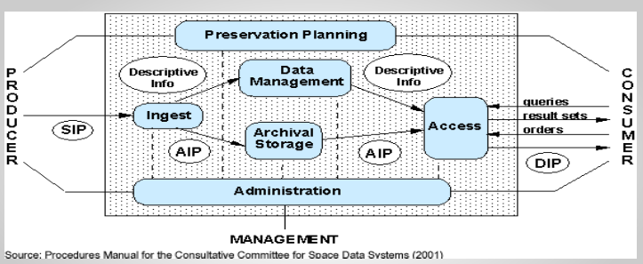
What is OAIS?
OAIS: Open Archival Information System, a theoretical model, ISO 14721:2012
Natural /easy in the analog world, more complex in the digital world

Slide 18
Parts of an official
Information Package (AIP)
part of the OAIS model!
Content Information
Preservation Description Information (PDI)
Content data object
Representation info
Reference
Provenance
Context
Fixity
packaging information
Note: Could be a Submission Info Package, Archival Info Package or Dissemination Info Package
descriptive information
(functionally AIP, not usually stored with it)
Notes:
Lavoie, Brian. OAIS System Reference Model Intro Guide 2004

Slide 19
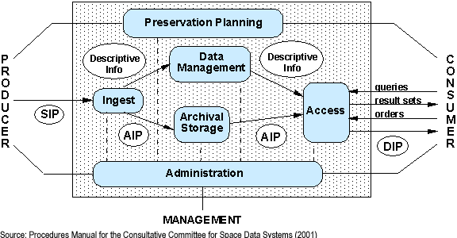
Media Files Metadata
Adapting OAIS model to fit our repository reality

Slide 20
Appraisal Weeding Analysis-what information do we need? Accesssion Archivist Toolkit Record Disk Image creation New file naming convention: MS/UA#aip_001
Adapting OAIS model to fit our repository reality

Slide 21
Archivists’ Toolkit/ ArchivesSpace DigiObject Spreadsheet
Adapting OAIS model to fit our repository reality

Slide 22
Dspace’s DDN server Online Nearline Dark Archive
Adapting OAIS model to fit our repository reality

Slide 23
Finding Aid
Adapting OAIS model to fit our repository reality

Slide 24
Dspace’s DDN server Online
Reading Room workstation Nearline
Adapting OAIS model to fit our repository reality

Slide 25
Files
Download version of image: jpg Zoom and pan version of image: jp2 PDF version of document Metadata
Adapting OAIS model to fit our repository reality

Slide 26
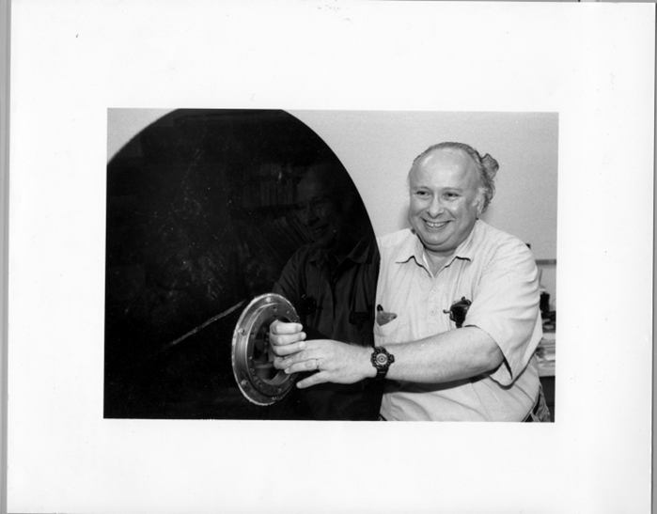
Option A: Creating a disk image
Joel Cyprus with disc platter from "Bryant bulk memory installed" in enclosed module, Rice University Computer Project, http://scholarship.rice.edu/handle/1911/71814
Disk imaging is the process of extracting unaltered bitstreams from digital media;
it creates a perfect capture of a device's file structure and all contents
(including hidden files and fragments) into one file, the “disk image”
Identifying tools to help us implement OAIS compliant system

Slide 27
Why use disk images in your
digital preservation program?
A more stable storage format with better contextual info
Capturing disk images in forensic formats such as E01 and AFF provides many advantages. The images can be stored compressed or uncompressed, can be split into multiple storage containers, can be parsed at the filesystem level without explicitly extracting the raw image, and embed provenance and capture metadata along with the bitstream.
Forensic images ensure that no inadvertent changes are made during pre-ingest chain-of-custody, and provide a consistent baseline for generating different types of access materials.”
Source: http://wiki.bitcurator.net/index.php?title=BitCurator_and_Archival_Workflows

Slide 28
Software
BitCurator (open-source) suite of digital forensics tools
Guymager: A GUI-based disk imaging program for capturing disk images in raw, E01, and AFF formats.
Bulk extractor and bulk extractor viewer: Simson Garfinkel's stream-based forensics tool for extracting features of interest from disk images (including but not limited to private and individually identifying information) and associated GUI front-end.
Fiwalk: Simson Garfinkel's tool for generating Digital Forensics XML output describing filesystem hierarchies contained on disk images.
BitCurator helps us to:
Create a disk image (.dmg) which preserves digital context,
Run detailed reports to assist with keeping the materials accessible over time
and to create a preservation description information (PDI)
Identifying tools to help us implement OAIS compliant system

Slide 29
BitCurator Site visit
Lee, C.A.; Olsen, P., Chassanoff, A., Woods, K.; Kirschenbaum, M., & Misra, S. (2014). From Code to Community: building and sustaining BitCurator through Community Engagement. Available at: http://www.bitcurator.net/wp-content/uploads/2014/11/code-to-community.pdf

Slide 30
BitCurator workstation
PC Workstation =approx. $1,000 (Windows 7 64-bit workstation with an i7 Intel processor, 24GB of RAM, and a 2TB SATA hard drive)
3.5” Floppy Drive =$20
External USB Hard Drives (100 TB)=$1,000
Based on Porter Olsen’s “Digital Curation Workstation” http://mith.umd.edu/digital-curation-workstation/

Slide 31
Option B: Other tools
Alternative strategies
exif tool
Bagger/Bag It
Droid
Identifying tools to help us implement OAIS compliant system

Slide 32
Task 3
Page 13 in the manual
Discuss with your group
Feel free to ask us questions

Slide 33
The present
And looking to the future…

Slide 34
Our Next Project
Email Account Preservation in XML
EMAP(Email Account Preservation Schema)
CERP Workflow
low tech
lean IT support
inactive accounts
EMCAP Workflow
dedicated IT support
active accounts

Slide 35
Creating an environment for Success*
Adjust standards to your reality
Identify initial priorities (WRC: policy → inventory → workflows →completed AIP)
Assess technical capabilities
Determine training needs
Determine staffing needs
Develop a prioritized, phased plan
Create a culture of tolerance (failure as building experience)
*SAA Digital Curation: Creating an Environment for Success July 2013 presentation
Notes:
*SAA Digital Curation: Creating an Environment for Success July 2013 presentation

Slide 36
Demonstrating/Defining success
Ability to acquire born-digital materials
Donors willing to give you born-digital materials
Ability to have staff work with born-digital materials
Have safe space to store digital archives
Have place available online to make materials accessible
Define success in small measurable steps

Slide 37
Keep on keeping on…
Document everything
Digital Projects wiki
Create timelines
Learn from each other
Share victories and challenges
Work with others in the community
Try to stay current with trends, continuing education…

Slide 38
Thanks! Contact Us!
Dara Flinn
Norie Guthrie
Rebecca Russell
All reachable via woodson@rice.edu
Boot Camp Manual: http://bit.ly/1PTG2hz
Woodson Research Center

